Slide 1
NEAT-TCP
Generation of TCP Congestion Control Through NeuroEvolution of Augmenting
Topologies for Wireless Multi-Hop Networks

Slide 2
Outline
Contributions
Background
NEAT-TCP
Evaluation
Discussion
Future Work

Slide 3
Contributions
NEAT-TCP: Design, implementation and evaluation of a tech- nique to generate neural networks for congestion control by neuroevolution.
Porting of iTCP, a recently published neural network based con- gestion control algorithm for WMNs, which serves as a perfor- mance benchmark, from ns-2 to ns-3.
Generation of two different flavours of congestion control
Evaluation of NEAT-TCP and comparison with iTCP and TCP New Reno, by means of throughput, mean end-to-end delay, packet loss and fairness.

Slide 4
Neural Networks (1)
McCulloch-Pitts Neuron Model:
[2]

Slide 5
Neural Networks (2)
Feed-Forward Neural Network:

Slide 6
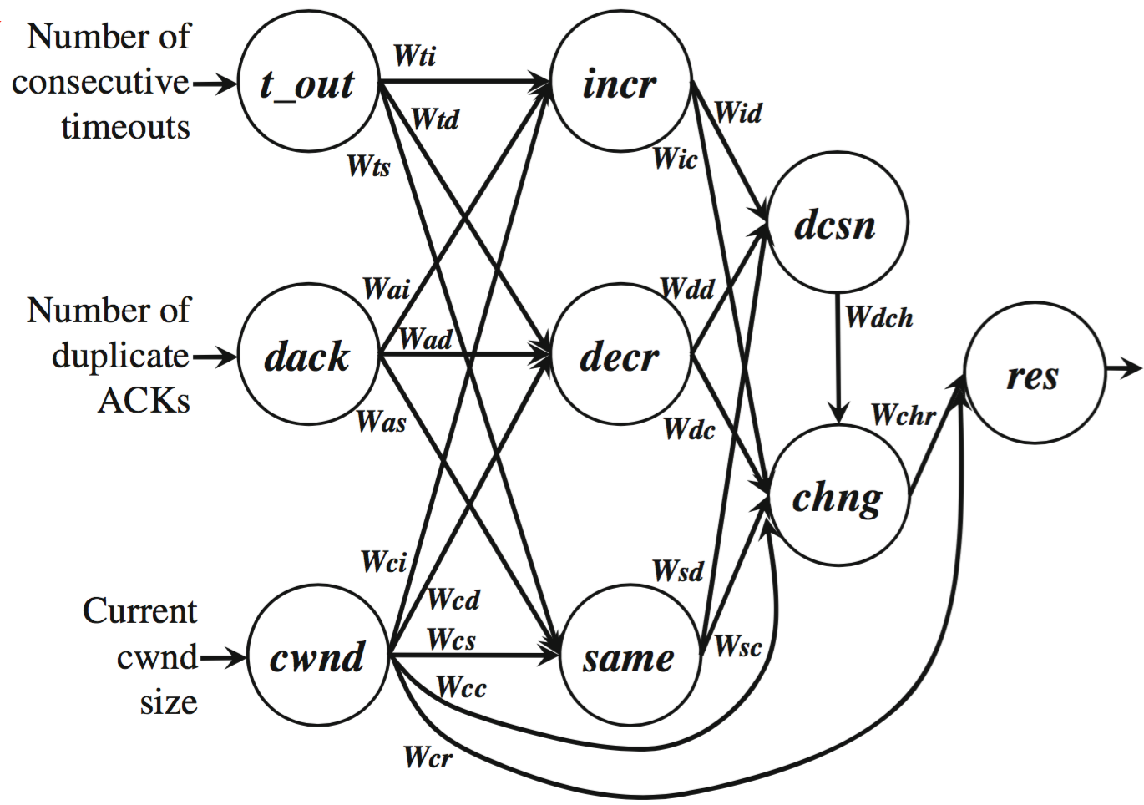
iTCP
Intelligent TCP
Feed-forward NN
Data driven approach
For Ad-Hoc networks
Originally built in ns-2
[3]

Slide 7
NEAT
NeuroEvolution of Augmenting Topologies
Kenneth O. Stanley and Risto Miikkulainen (2002)
Genetic algorithm (evolution)
Prominent in machine learning for games
For example: MarI/O
NEAT evolves NNs that play and finish Super Mario levels.

Slide 8
NEAT – Mutations
- Four different mutations:
- Link Weight Mutation
- Add Link Mutation
0
1
0
0

Slide 9
NEAT – Mutations
- Four different mutations:
- Switch Link Mutation
- Add Node Mutation
1
0.32
0.32

Slide 10
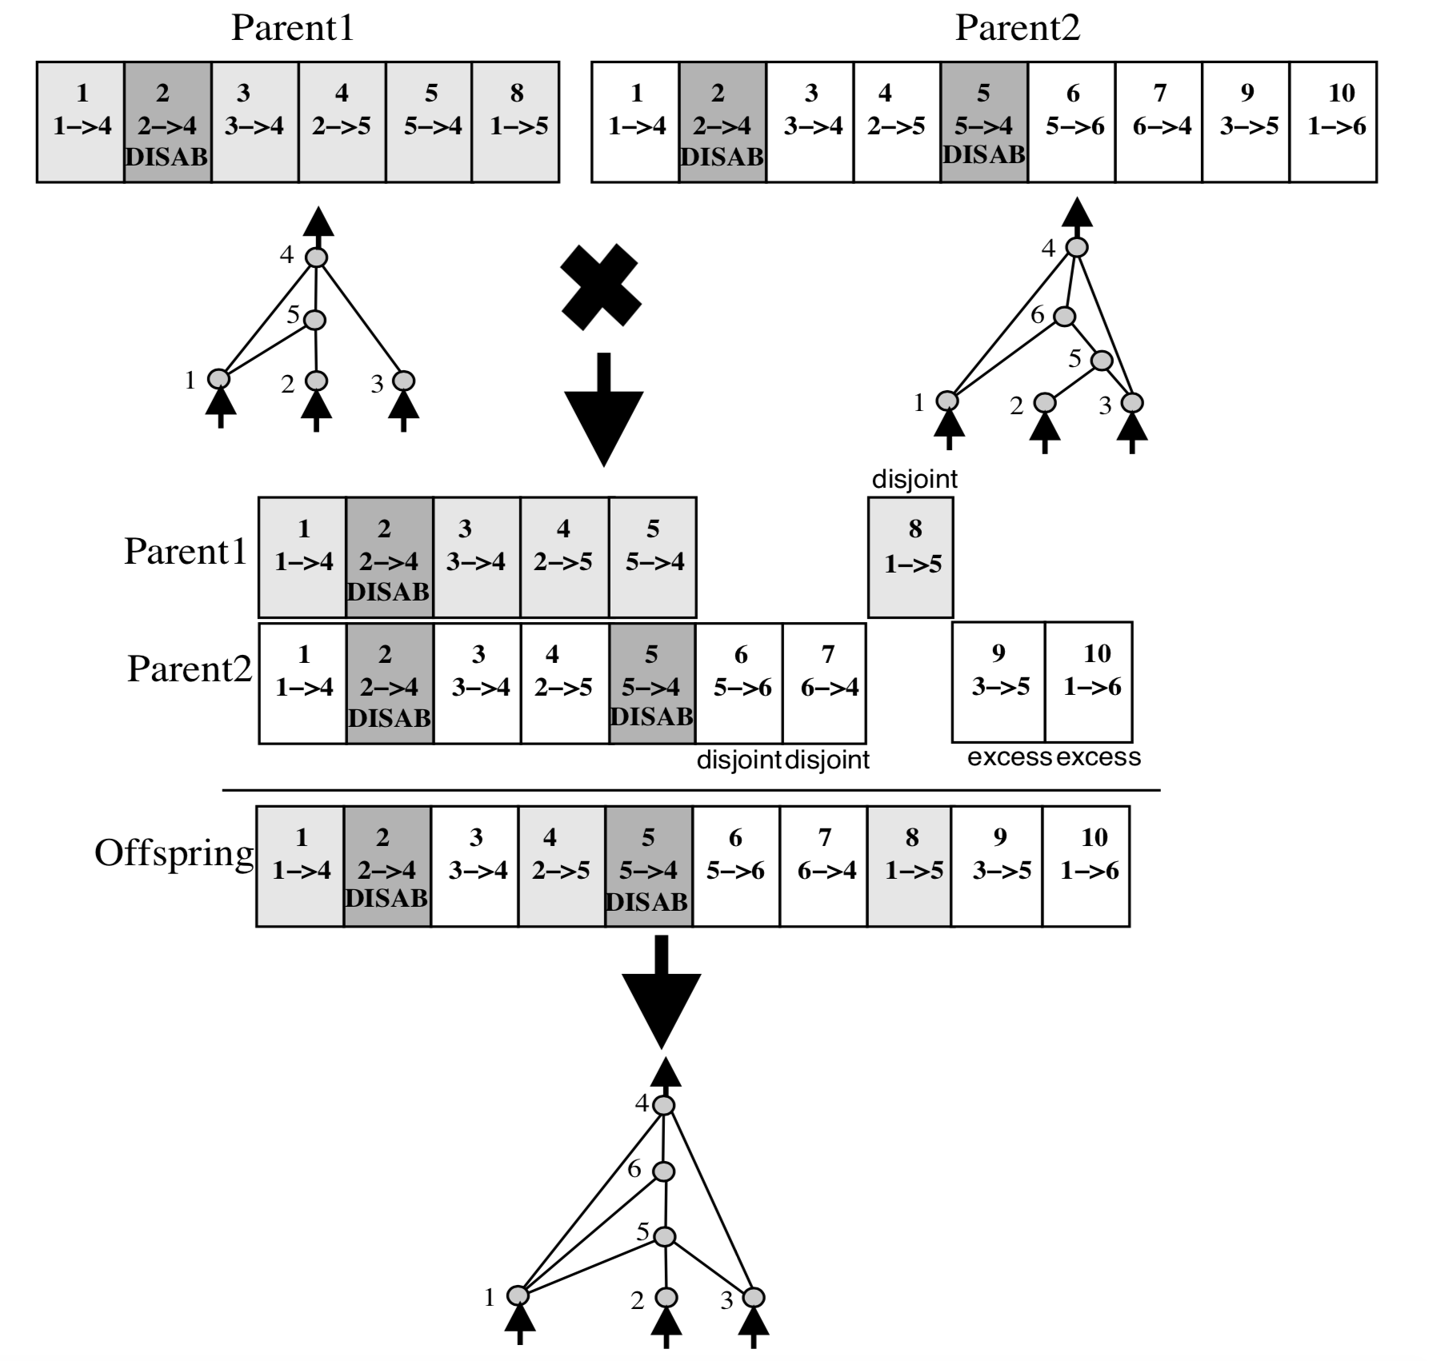
NEAT – Mating/Speciation
[4]

Slide 11
NEAT – Iteration

Slide 12
NEAT-TCP (1)

Slide 13
NEAT-TCP (2)
Initial NN:
Parameters:
Recurrent Probability: 5%
Mutate Link Probability: 80%
Toggle Link Probability: 10%
Add Node Probability: 1%
Add Link Probability: 30%
Population Size: 500 Organisms
Dropoff Age: 15
Epochs: 100

Slide 14
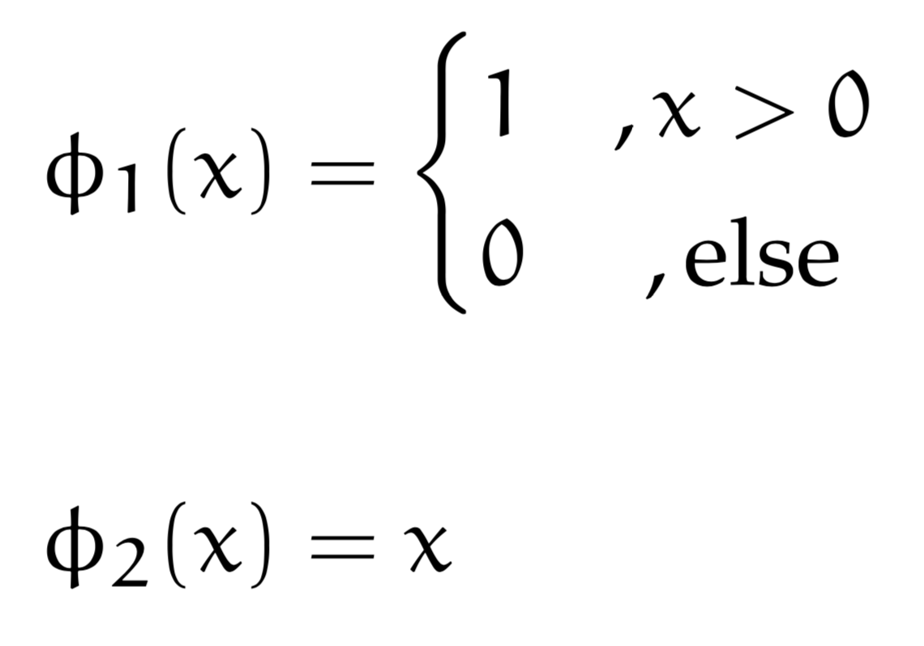
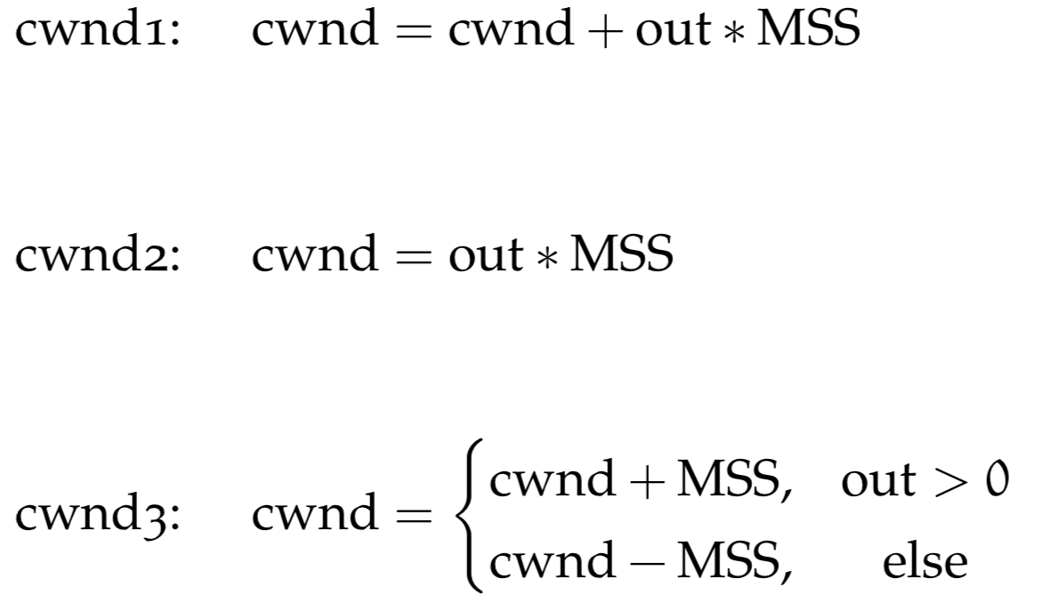
NEAT-TCP (3)
Activation Functions:

Slide 15
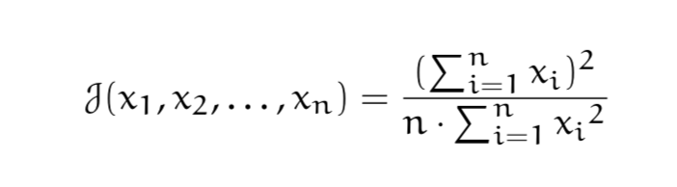
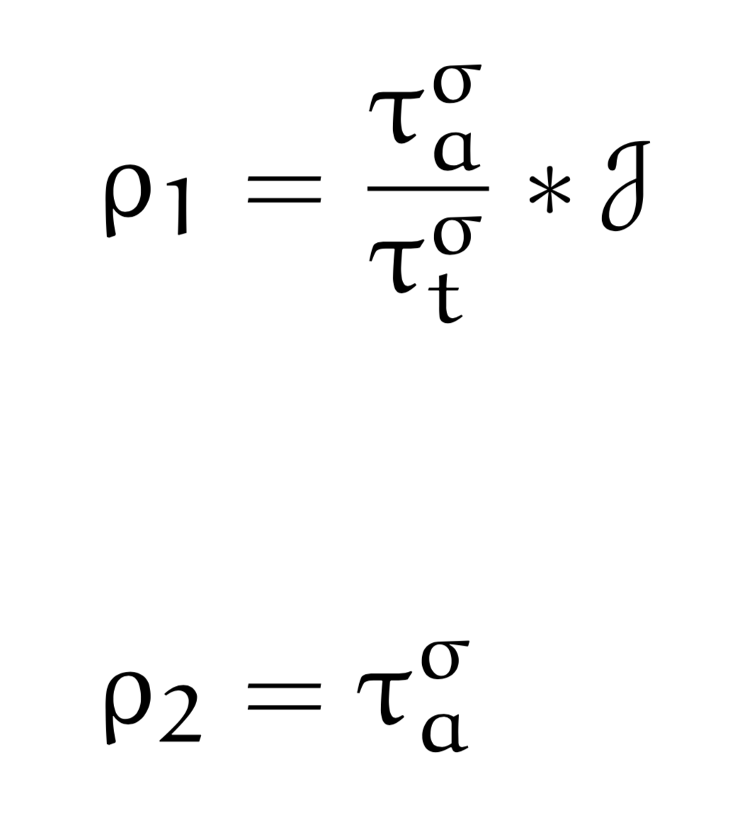
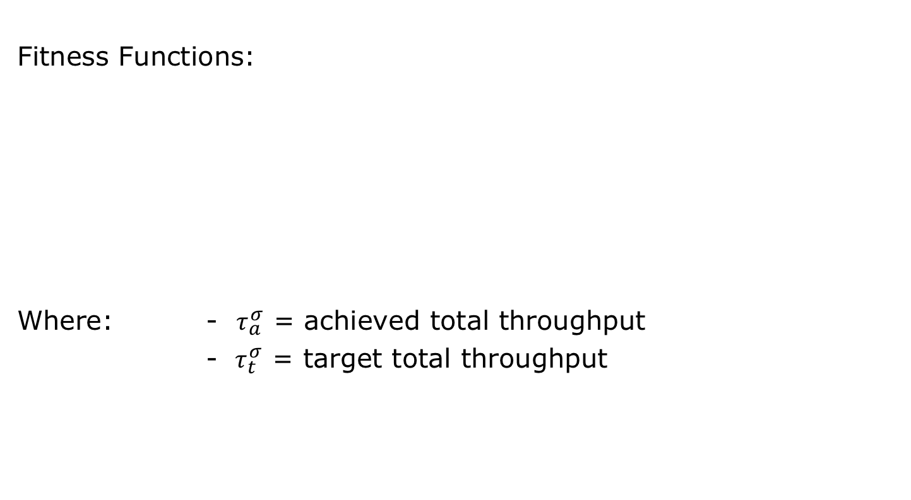
NEAT-TCP (4)
Fitness Functions:
Where: - $τ_{a}^{σ}$ = achieved total throughput
-$τ_{t}^{σ}$ = target total throughput
Jain‘s fairness index

Slide 16
NEAT-TCP (5)
Time Points of Evaluation
PktAcked:
Every time a packet is acknowledged, the NN is evaluated and the cwnd is changed accordingly
Increase Window:
Every time New Reno would increase the cwnd, the NN is evaluated and the cwnd is changed accordingly

Slide 17
Experimental Setup
Simulation time: 40s
Radio: 1 Mbps (802.11b)
Flow rate: 1 Mbps
RTS/CTS
Buffer size: 50 pkts
25 nodes in 5x5 grid
All flows start at the same time
Nodes can only reach horizontal/vertical neighbours not diagonal

Slide 18
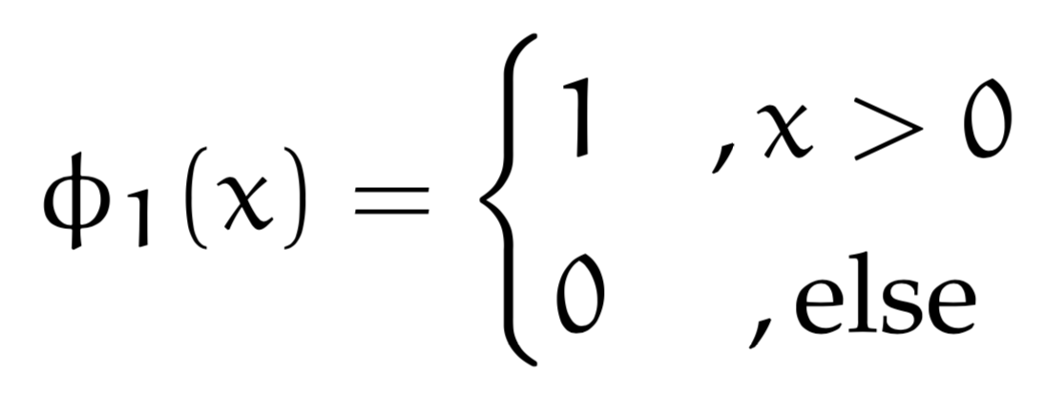
Experiments Results
Best results for both fitness functions with
Evaluated every time a packet is acknowledged.

Slide 19
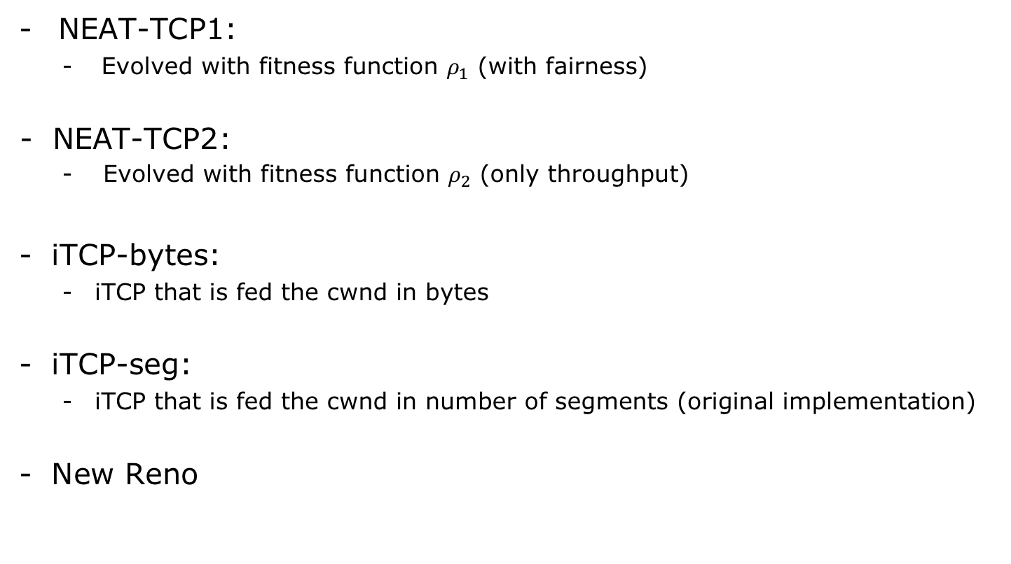
Evaluation
NEAT-TCP1:
Evolved with fitness function $ρ_{1}$ (with fairness)
NEAT-TCP2:
Evolved with fitness function $ρ_{2}$ (only throughput)
iTCP-bytes:
iTCP that is fed the cwnd in bytes
iTCP-seg:
iTCP that is fed the cwnd in number of segments (original implementation)
New Reno

Slide 20
Evaluation – Throughput

Slide 21
Evaluation – Fairness

Slide 22
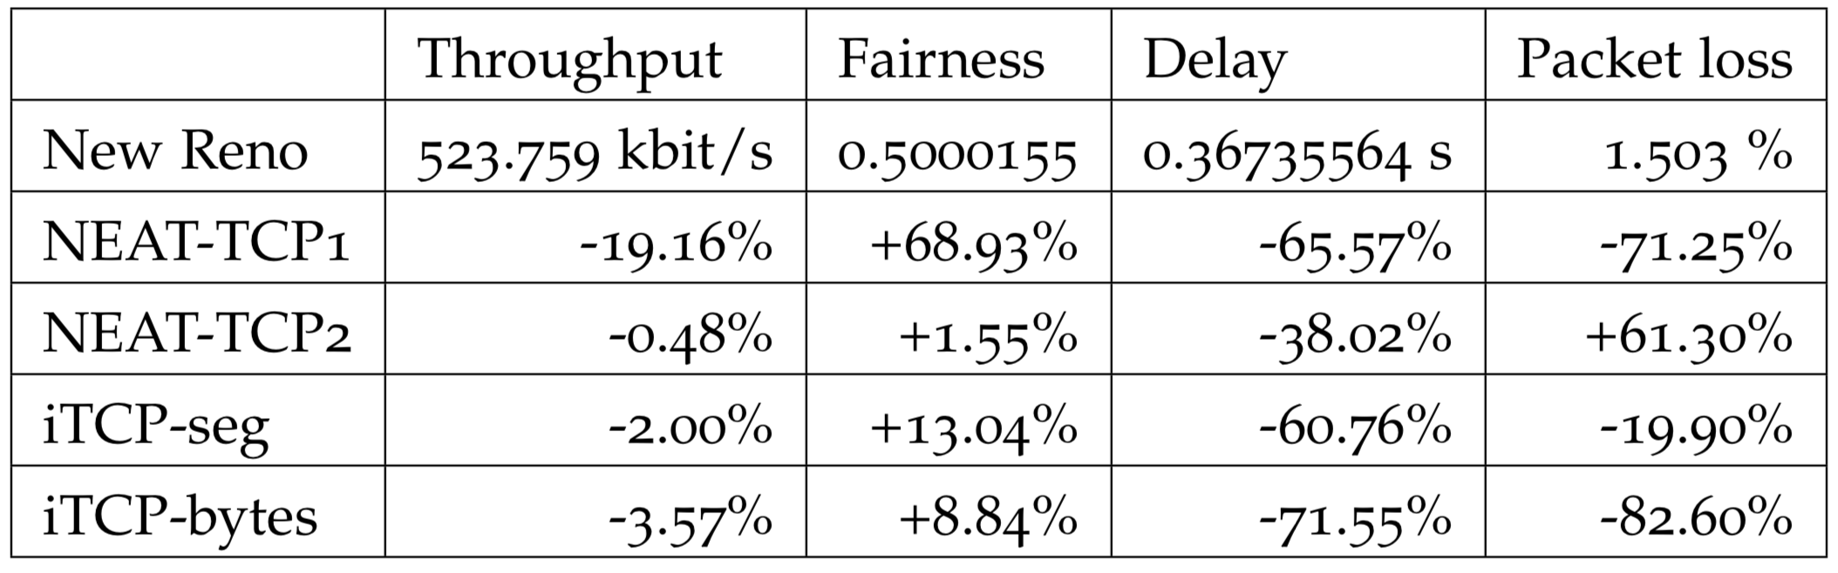
Evaluation – Results

Slide 23
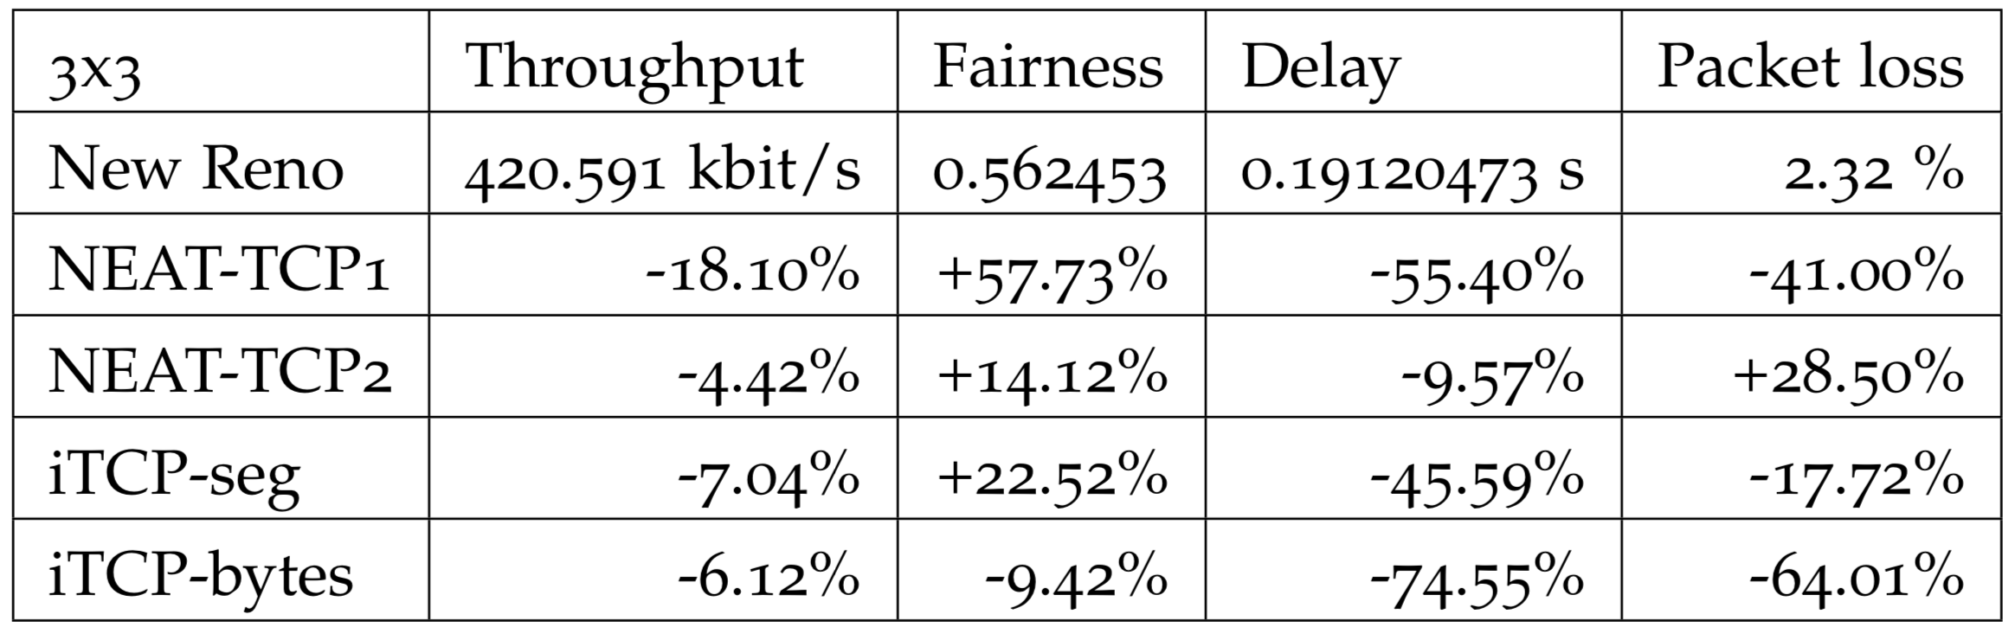
Evaluation in different topologies

Slide 24
NEAT-TCP Convergence
Three stop criteria:
Target fitness achieved
Number of epochs reached
Abortion by user
Based on randomness
Generally, with larger population:
Faster (in terms of epochs)
More structural minimal solutions
Higher chance of finding a solution

Slide 25
NEAT-TCP Applicability
Could work in other environments
Wired
Mobile Networks
Etc.
NEAT-TCP works for a range of networks
(generated for 5x5 but has respectable performance in 3x3)
But not tested in different flow configurations
Industrial/Commercial context
Generate a NEAT-TCP before shipping/installation of network

Slide 26
Future Work
Parallelise ns-3
Larger Population Size
Provide more scenarios for generalised NNs
Support for multiple activation functions within one NN in NEAT
Evaluate NEAT-TCP on a real testbed
NEAT-Routing
Routing with optimisation targets like energy consumption

Slide 27
Thank you for your attention!
[1] Sumit Rangwala, Apoorva Jindal, Ki-Young Jang, Konstantinos Psounis, and Ramesh Govindan. “"Understanding congestion control in multi-hop wireless mesh networks".” In: MobiCom 08, Proceedings of the 14th ACM international conference on Mobile computing and networking (2008), pp. 291–302.
[2] Warren McCulloch and William Pitts. “"A logical calculus of the ideas immanent in nervous activity".” In: Bulletin of Mathe- matical Biophysics (1943), pp. 115–133.
[3] A. B. M. Alim Al Islam and Vijay Raghunathan. “iTCP: an in- telligent TCP with neural network based end-to-end conges- tion control for ad-hoc multi-hop wireless mesh networks.” In: Springer: Wireless Networks, The Journal of Mobile Communication, Computation and Information (Feb. 2015).
[4] Kenneth O. Stanley and Risto Miikkulainen. “Evolving Neural Networks Through Augmenting Topologies.” In: Evolutionary Computation 10.2 (2002), pp. 99–127. url: http://nn.cs.utexas. edu/?stanley:ec02.

Slide 28
Copyright Notice
This document has been distributed by the contributing authors as a means to ensure timely dissemination of scholarly and technical work on a non-commercial basis. Copyright and all rights therein are maintained by the authors or by other copyright holders, notwithstanding that they have offered their works here electronically.
It is understood that all persons copying this information will adhere to the terms and constraints invoked by each author’s copyright. These works may not be reposted without the explicit permission of the copyright holder.

Slide 29
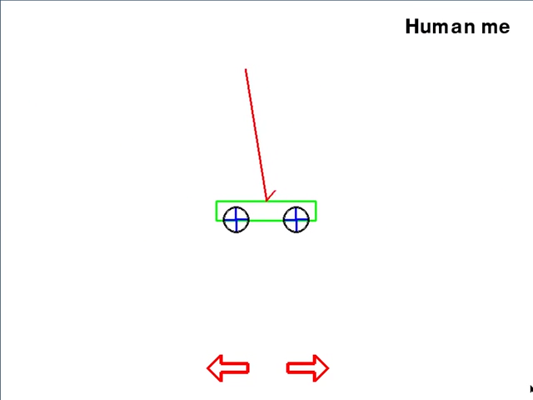
Why these parameters?
Same parameter file used as in double pole balancing on a cart:
[3]
Notes:
Congestion control similar to control technology problems
But Congestion control is distributed
Indirect tinkering

Slide 30
Evaluation – Packet Loss

Slide 31
Evaluation – Delay

Slide 32
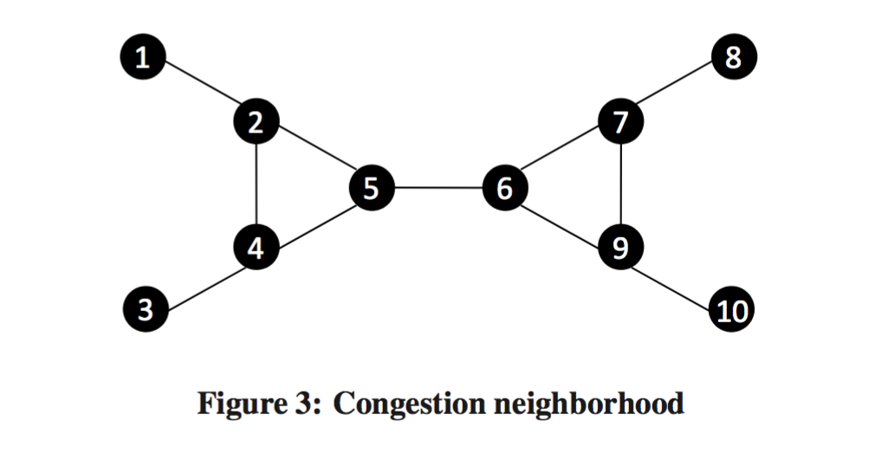
Why is Congestion Control a difficult task in multi-hop WMNs?
CC is triggered because of wrong assumption
Congestion depends not only on a single node, but is a neighborhood phenomenon. (2 hop range)
[1]

Slide 33
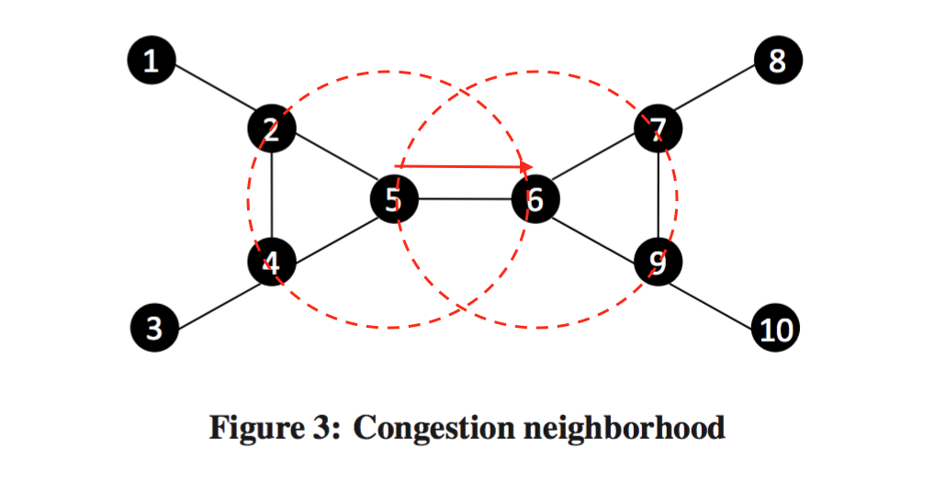
Why is Congestion Control a difficult task in multi-hop WMNs?
Congestion depends not only on a single node, but is a neighborhood phenomenon. (2 hop range)
[1]
Notes:
RTS/CTS

Slide 34
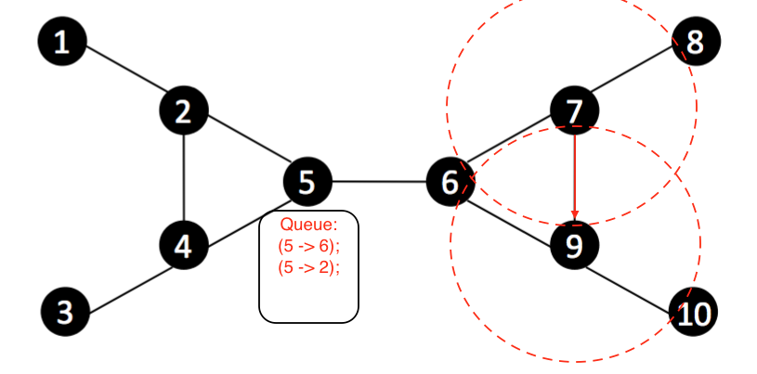
Challenges of TCP Congestion Control in Wireless Mesh networks
Congestion is a neighborhood phenomenon.
RTS/CTS -> Head of line blocking effect.
[1]
[1]

